Slide 2
The roadmap for SQL Server
BRK2416
Bob Ward, Principal Architect, Microsoft
Amit Banerjee, Principal Program Manager, Microsoft
Asad Khan, Principal PM Manager, Microsoft

Slide 3

SQL Server 2019
Industry-leading performance and security, with intelligence over all your data
Intelligence over any data
Choice of platform and language
Industry-leading performance
Most secure over the last 8 years⁵
Insights in minutes and rich reports
+
#1 OLTP performance¹
#1 DW performance on 1TB², 10TB³, and 30TB⁴
Intelligent Query Processing
PHP
Node.js
C#/VB.NET
AI and Machine Learning over all data with the power of SQL and Apache Spark
T-SQL
Java
C/C++
Python
Ruby
The best of Power BI and SQL Server Reporting Services with Power BI Report Server
In-memory across all workloads
Most consistent data platform
Private cloud
1/10th the cost of Oracle
Public cloud
All TPC Claims as of 1/19/2018.
¹ http://www.tpc.org/4081; ² http://www.tpc.org/3331; ³ http://www.tpc.org/3326; ⁴ http://www.tpc.org/3321; ⁵ National Institute of Standards and Technology Comprehensive Vulnerability Database

Slide 4
SQL Server 2019 enables intelligence over all your data
Integrating all data
Managing all data
Analyzing all data
Unified access to all your data with unparalleled performance
Easily and securely manage
data big and small
Build intelligent apps and AI with all your data
Simplified management and analysis through a unified deployment, governance, and tooling

Slide 5
All on a unified data services platform
Connect to all of your data
Including Relational, noSQL, Hadoop
Create intelligence from all your data
Using Apache Spark and SQL
Manage this through a single pane of glass
With Azure Data Studio

Slide 6
SQL Server 2019 big data, analytics, and AI
Data virtualization
Managed SQL Server, Spark, and data lake
Complete AI platform
Admin portal and management services
Integrated AD-based security
Analytics
T-SQL
Apps
REST API containers for models
SQL Server External Tables
SQL Server
Spark
SQL Server
ML Services
Spark & Spark ML
Compute pools and data pools
Scalable, shared storage (HDFS)
Open database connectivity
NoSQL
Relational databases
HDFS
External data sources
HDFS
Combine data from many sources without moving or replicating it
Scale out compute and caching to boost performance
Store high volume data in a data lake and access it easily using either SQL or Spark
Management services, admin portal, and integrated security make it all easy to manage
Easily feed integrated data from many sources to your model training
Ingest and prep data and then train, store, and operationalize your models all in one system

Slide 7
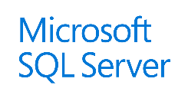



SQL Server big data clusters
Custom apps
BI
Analytics
Cluster
SQL
SQL Server master instance
External data sources
Compute pool
Compute pool
Compute pool
Directly read from HDFS
SQL Compute Node
SQL Compute Node
SQL Compute Node
SQL Compute Node
…
SQL Compute Node
Data mart
Storage pool
SQL Data Node
SQL Data Node
Spark
SQL Server
Spark
SQL Server
…
Spark
SQL Server
HDFS Data Node
HDFS Data Node
HDFS Data Node
IoT data
Storage
Storage
Kubernetes pod
Node
Node
Node
Node
Node
Node
Node
Persistent storage

Slide 8
Demo: Unified Data Hub
Amit Banerjee

Slide 9
The heart of SQL Server is mission critical performance, security, and availability
Performance
Security
Availability
Breakthrough performance and scalability
Data protected at rest and in motion
High availability for business critical workloads

Slide 10
Mission critical performance The intelligent database
The Intelligent Query Processing feature family
Intelligent QP
Intelligent Query Processing
Gain performance insights anytime and anywhere with Lightweight Query Profiling
Accelerating I/O performance with Persistent Memory
Adaptive QP
Table Variable Deferred Compilation
Batch Mode for Row Store
Approximate QP
Adaptive Joins
Interleaved Execution
Memory Grant Feedback
Approximate Count Distinct
Batch Mode
Batch Mode
Row Mode
Bold indicates new and improved features in SQL Server 2019

Slide 11
Demo: The intelligent database
Bob Ward

Slide 12
Mission critical security Confidential computing
Always Encrypted with secure enclaves
Always Encrypted with secure enclaves
Data Classification and auditing built-in
Manage certificates easier with SQL Configuration Manager
plaintext
ciphertext
Enhanced client driver
Enclave
plaintext

Slide 13
Mission critical availability Keep SQL Server running
Availability groups on Kubernetes
Kubernetes cluster
Node
Node
Pod
Pod
Operator
Load balancer
Always On availability group enhancements
Resumable online index creation
Online Clustered Columnstore index creation and rebuild
Availability groups on Kubernetes
Reporting app
Node
Node
Node
Pod
Pod
Pod
AG
SQL Server primary
SQL Server primary
SQL Server secondary
SQL Server secondary
SQL Server secondary
AG agent
AG agent
AG agent
Node
Pod
Load balancer
Primary app

Slide 14
The modern development platform
Speed app development and admin with new enhancements
Develop on your choice of language and tooling

Slide 15

Enhancing the developer experience
Extend T-SQL with R, Python, and Java
Satellite
R
SQL Graph enhancements
UTF-8 support
Machine Learning Services enhancements
SQL Server Java extension
SQL Server
T-SQL
Direct communications for performance
Launch pad

Slide 16
Demo: The modern development platform
Bob Ward

Slide 17
Enhancing the platform of choice
Windows
Linux
Closing features gaps for SQL Server on Linux
Replication
Distributed transactions
Machine Learning
Open LDAP Provider support
The Microsoft Container Registry
SQL Server RedHat Container Images
Always On Availability Groups on Kubernetes
Docker containers and Kubernetes

Slide 18
We listened to you!
Your feedback drives improvements to the SQL Server engine, tooling, and future investments

Slide 19
Tuning the SQL Server engine
In-Memory ColumnStore
Columnstore stats in DBCC CLONEDATABASE
Estimate compression for Columnstore indexes
Troubleshoot page resource waits with new built-in T-SQL
0100101010110
!
In-Memory OLTP

Slide 20
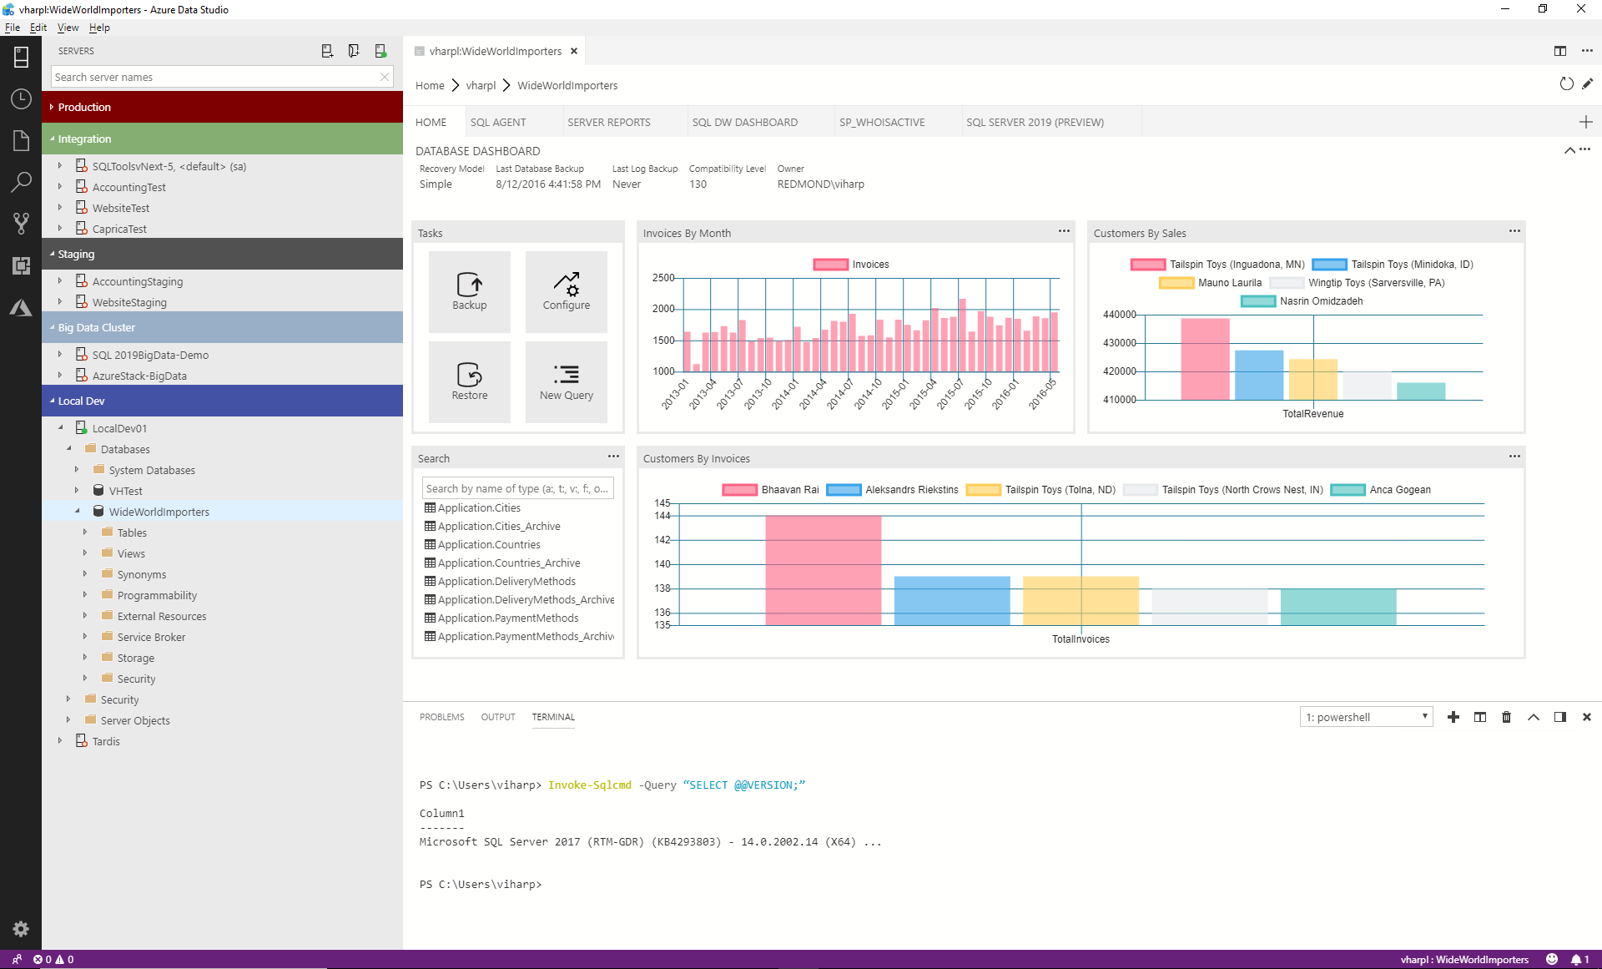
The Azure Data Studio tools experience
Azure Data Studio is a lightweight, open source, cross-platform graphical management tool and code editor
Enable a modern DevOps experience for database developers and DBAs on their platform of choice​
Simplify development, configuration, management, monitoring and troubleshooting for SQL databases on-premises and in the cloud^{NEW}
Use SQL Server Management Studio 18.0 Preview to access, configure, manage, and administer all SQL Server components

Slide 21
Investments in the future of SQL Server
SQL Server on Edge
Finish features for big data clusters and data virtualization
Making SQL Server more available, faster
Further enhance SQL Server security
Enhance the engine to align with hardware innovation
Continue to make the container experience great
Engine improvements based on customer feedback

Slide 22
Learn more
Preview SQL Server 2019 now: https://aka.ms/ss19
Join the early adoption program: https://aka.ms/eapsignup
See what’s new in CTP 2.0: http://docs.microsoft.com/sql/sql-server/what-s-new-in-sql-server-ver15
Learn more at other sessions
Session number | BRK2229 | BRK2167 | BRK3228
Title | The future of SQL Server and big data | Cross platform tooling for SQL Server | What’s new in SQL Server on Linux and containers

